Slide 1
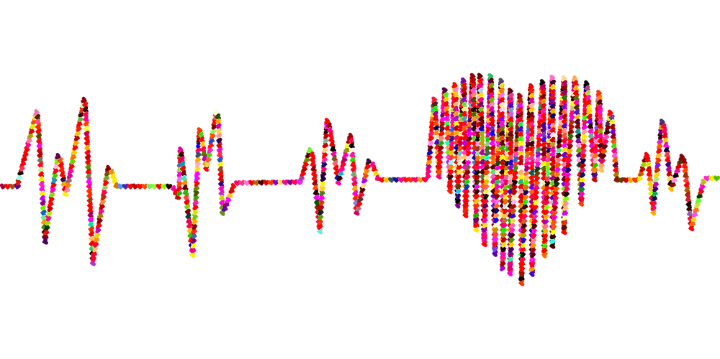
Data Analytics Bootcamp –UOT Final Project - Group 7
PREDICTION OF FACTORS LEAD TO HEART DISEASE

Slide 2
CONTENTS
Overview
Objective
Exploratory Data Analysis
Data Storage
Machine Learning Models
Dashboard
Conclusion
Our team

Slide 3
OVERVIEW :
According to the WHO, heart diseases are the leading cause of death globally. Approximately 17.9 million people die each year from heart diseases and estimated around 32% of all deaths worldwide. There have been identified many important factors which lead to heart disease. Identifying those risk factors and motivating people to adopt and following healthy behaviours is very important.

Slide 4
OBJECTIVE:
Our team use a heart disease dataset with different factors to predict which factors are at highest risk of leading to heart disease. Our team’s target audience would be the health care professionals as they will be able to apply the most current and up to date research and evidence to patient care and helping people preventing premature deaths related to heart diseases.

Slide 5
EXPLORATORY DATA ANALYSIS

Slide 6
Data Sources & Resources
Data Source: heart_disease_key_indicators.csv
Software: Python 3.7.10, Visual Studio Code 1.38.1, Jupyter Notebook, Anaconda3, PgAdmin.
Resources: https://www.kaggle.com/datasets?search=heart+disease.

Slide 7
Understand the Data
Importing libraries and files for exploratory data analysis
Clean the Data
Analysis of relationship between variables
Creating data frame and checking number of columns and rows.
Checking the data types.
Checking the data characters mistakes.
Checking the null values.
Checking and removing the duplicates.
Transforming the target variable.
Loading data
Target variable visualization
Other variable against target variable visualizations.
Correlation Visualization.

Slide 8
Features
Independent Variables
Categorical
Smoking, AlcoholDrinking,Stroke,Sex , PhysicalActivity, Asthma, KidneyDisease,SkinCancer, Diffwalking
Continuous
BMI, PhysicalHealth,MentalHealth, AgeCategory, GeneralHealth, Diabetic,Sleeptime,
Race
Dependent Variables
HeartDisease (Categorical)

Slide 9
Features Analysis
Categorical Variables ( Binary ) | Continuous Variables ( Non Binary )
HeartDisease Smoking AlcoholDrinking Stroke Diffwalking PhysicalActivity Asthma KidneyDisease SkinCancer Sex | BMI – Healthy Weight, Obesity, Over Weight, Under Weight PhysicalHealth – Index Number Race – Native, White, Black, Asian, Hispanic, Other MentalHealth – Index Number Age Category – In Years General Health – Excellent, Very good, Good , Fair , Poor Diabetic – Yes, No , Border line, During Pregnancy Sleeptime – In hours
Yes – 1
No – 0
Female – 1
Male – 0

Slide 10
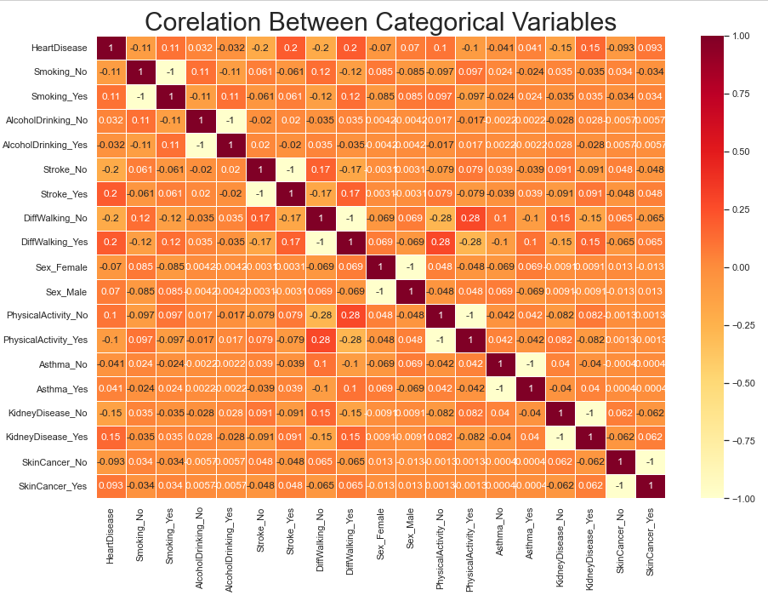

Slide 11
DATA STORAGE Creating tables for binary and nonbinary data using SQL Joining tables using id number as the primary key Storing data using Pgadmin

Slide 12
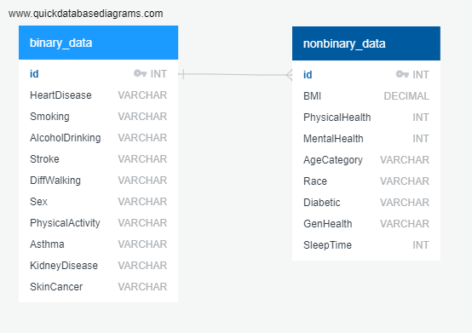
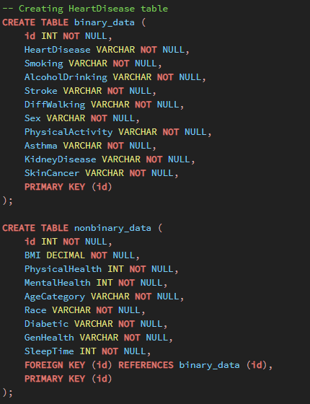

Slide 13
MACHINE LEARNING MODELS

Slide 14
Logistic Regression Model | Random Forest Classifier
Splitting the data into training and testing Create logistic regression model Fit train or model using the training data Make Predictions Validate the model using the test data | Preprocess the data Fit the random forest model Make predictions using the testing data Evaluate the model Rank the importance of features

Slide 15
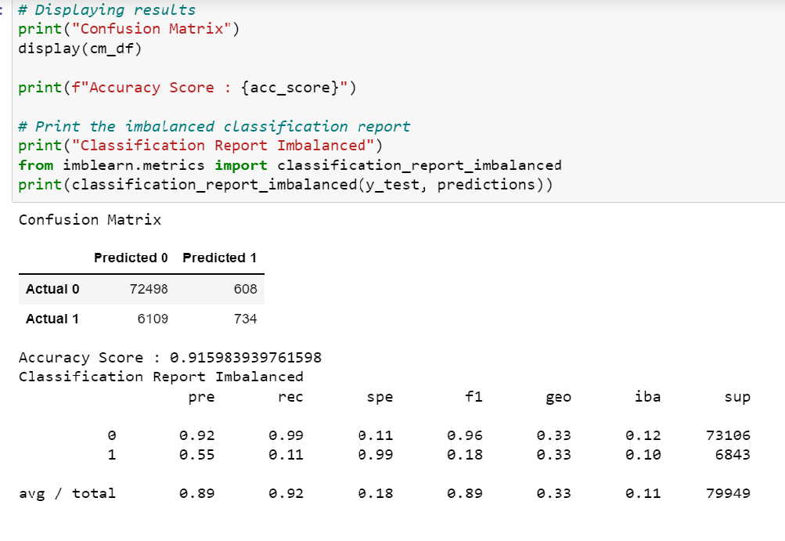
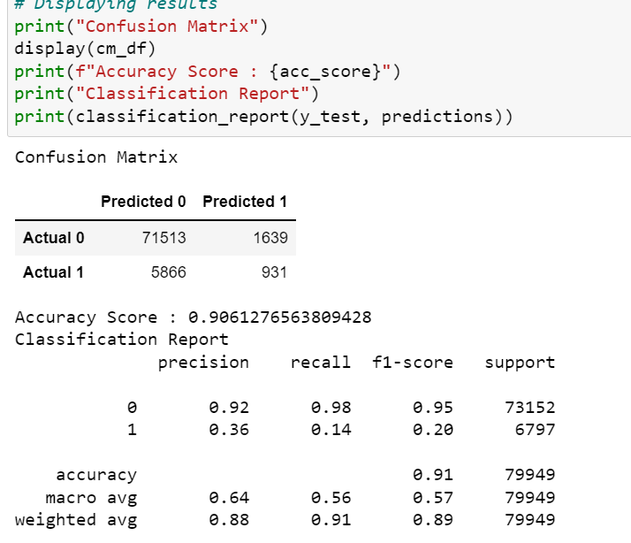
Logistic Regression and Random Forest Classifier

Slide 16
DASHBOARD

Slide 17
Dashboard Elements
For the dashboard segment ,we have used Tableau Public and please click here view the interactive dashboard embed.
Number of people with heart disease will be the key element of the dashboard and how it interacts with other elements such as alcohol drinking, Diabetic, Kidney Disease and Asthma will be shown on the dashboard.

Slide 18
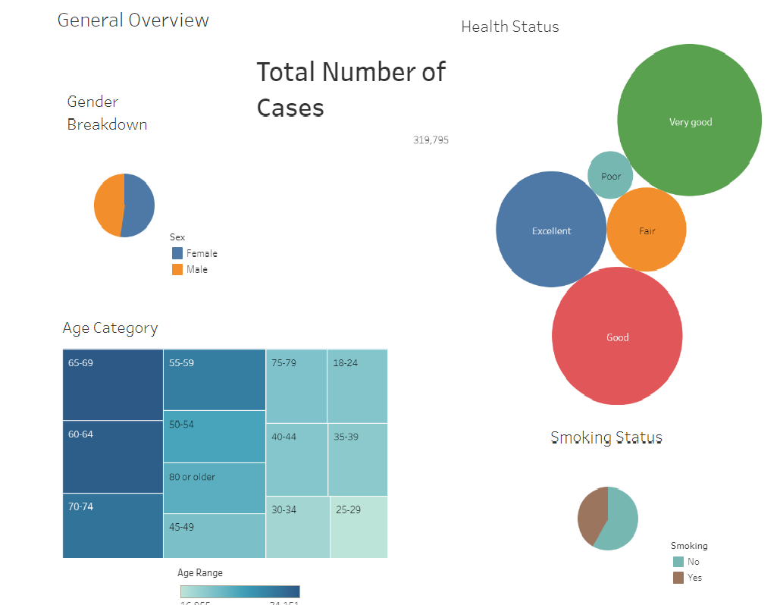

Slide 19
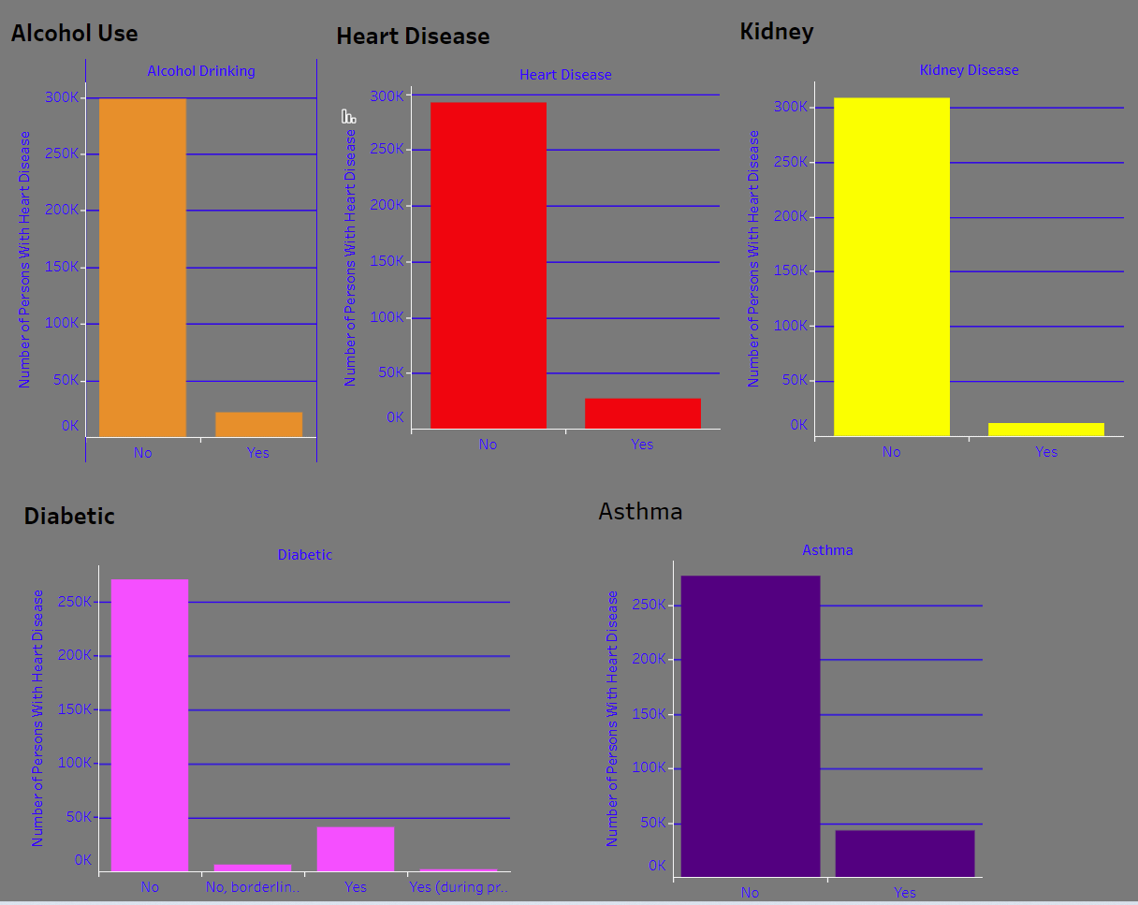

Slide 20
CONCLUSION

Slide 21

Analytical Questions
What are the key indicators that lead to heart disease ?
What factors had the greatest influence on a person developing heart disease and in what proportions ?
Can a machine learning model accurately predict whether a person will develop heart disease based on the data provided ?

Slide 22
After completing the project we will be analysing our machine learning models we created.
We will be considering designing and training deep learning neural network model based on the final analysis output.

Slide 23








The Team
Ethan McBride
Andres Pombo
Sergei Zhukov
Marian Salgadoe
Thank you

